Slide 1
Push Ups for Beginners
By Morgan Nicora

Slide 2

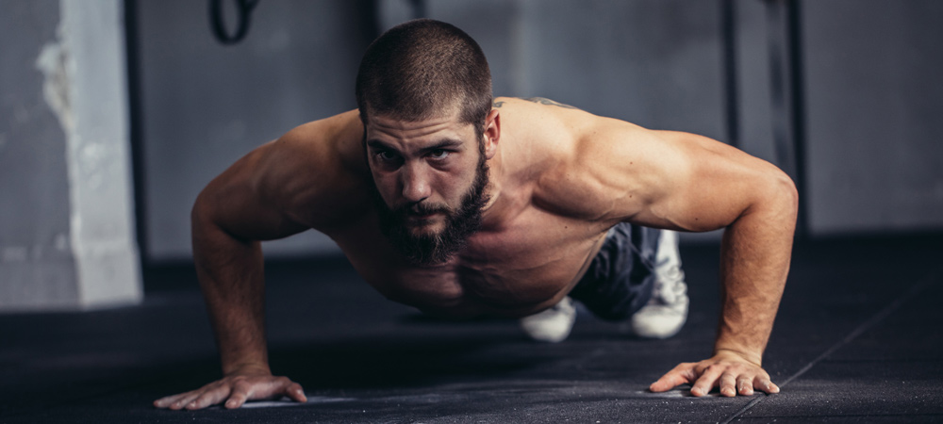
Why Should You Progress to a Full Push Up
Injury prevention
Learn good form first
Get the full benefit of the exercise
https://www.elitedaily.com/women/phrase-girl-push-ups-needs-retired-already/1990791
https://www.fashionbeans.com/article/100-push-ups-a-day/

Slide 3
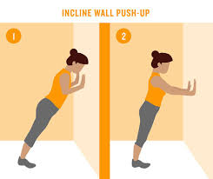
Progressions
Wall Push Up
  Place both hands shoulder width apart on wall.
  Stand on a slight incline and keep spine in aligned, neutral position.
  Descend by bending the elbows at the side of the body
  Return to starting position by pushing yourself away from the wall
https://www.northwestpharmacy.com/healthperch/hit-wall-fitness-routine-take-workout-wall/hit-wall-fitness-routine-001

Slide 4
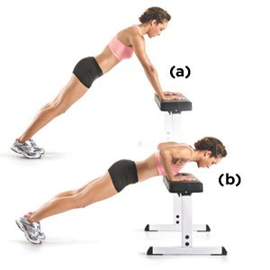
Progressions
Incline Push Up
  Use a barbell & squat rack, a box, or a bench
  Use same form as the wall push up
  Continue to lower the barbell, box, or bench before progressing on
https://www.womenshealthmag.com/fitness/a20698060/incline-pushup-0/

Slide 5
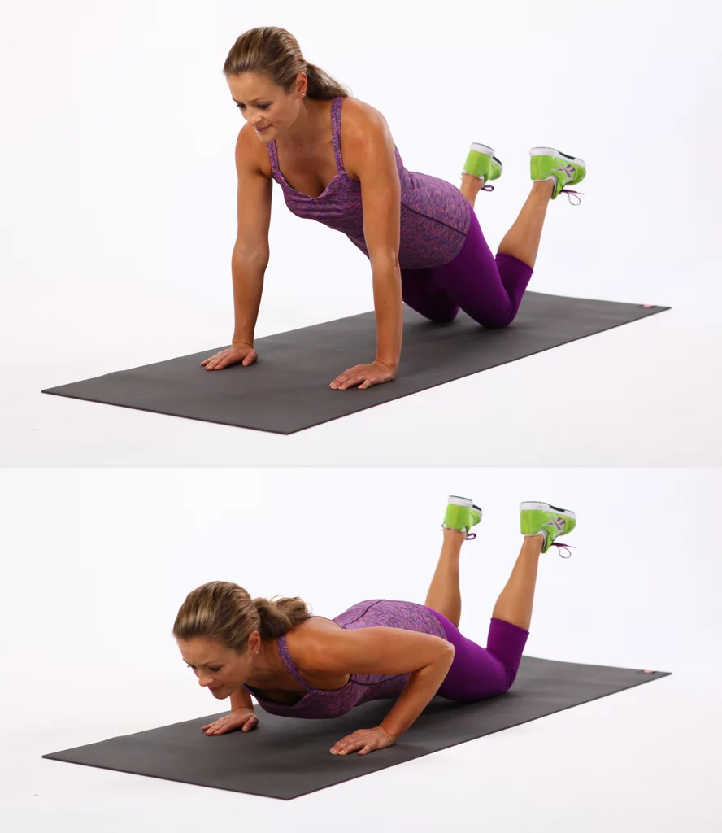
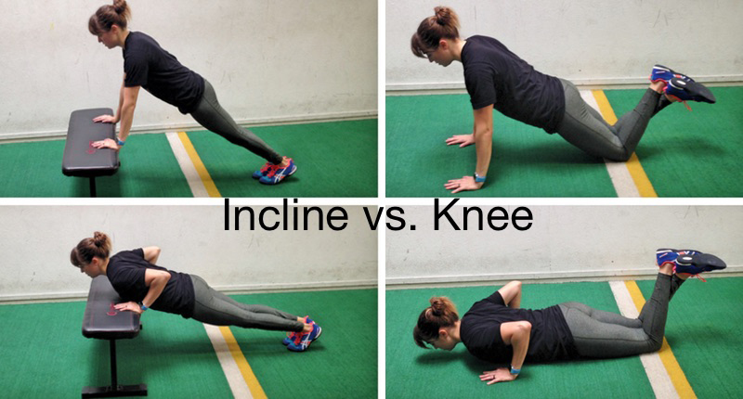
Progressions
Kneeling Push Up
  Start on the floor with hands shoulder width apart
  Keep knees on the ground and bent at 90 degrees
  Keep spine straight in neutral position
  Descend and ascend same as wall and incline push up
https://www.popsugar.com/fitness/photo-gallery/39361000/image/39361039/Knee-Push-Ups
https://www.azumio.com/blog/fitness/improve-your-push-ups

Slide 6
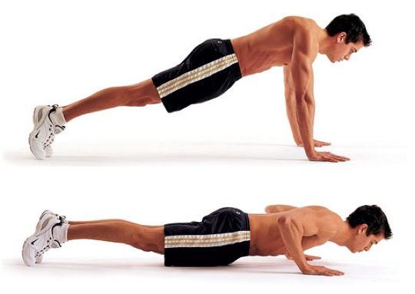
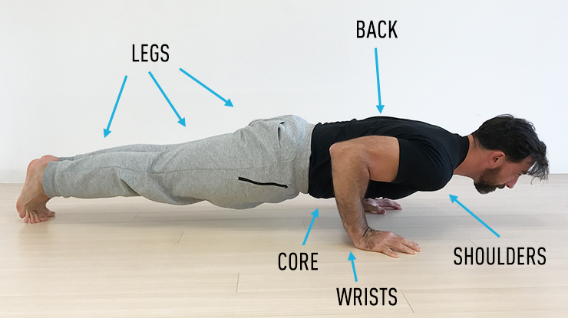
Progressions
Full Push Up
  Start in high plank position
    Hands shoulder width apart, neutral spine
  Lower body by bending the elbows at your side.
    Your whole body should be lowered while keeping spine neutral.
  Stop once your chest is a few inches above the ground
    Elbows should be bent at 90 degrees at this point
  Push self up, away from the ground to start position
https://www.stack.com/a/pyramid-push-ups
https://gmb.io/push-up/

Slide 7
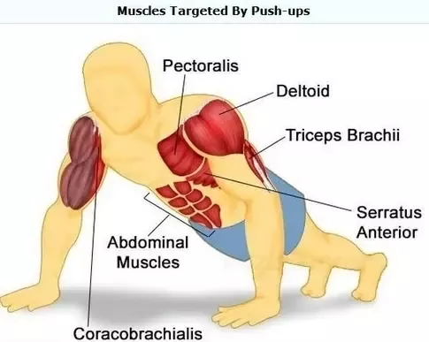
Muscles to Engage
Muscles used in push up
  Pectorals
  Triceps
  Anterior Deltoids
  Abdominal Muscles
https://www.quora.com/What-muscles-do-push-ups-work

Slide 8
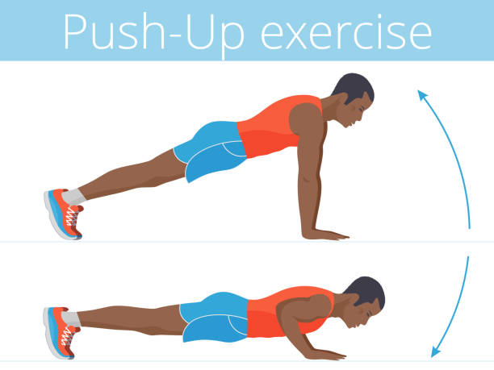
Benefits to Push Ups
Increase overall strength
Improve functional strength
Improve shoulder health
Upper body muscle definition
No weights needed
https://www.istockphoto.com/illustrations/push-ups?sort=mostpopular&mediatype=illustration&phrase=push%20ups

Slide 9
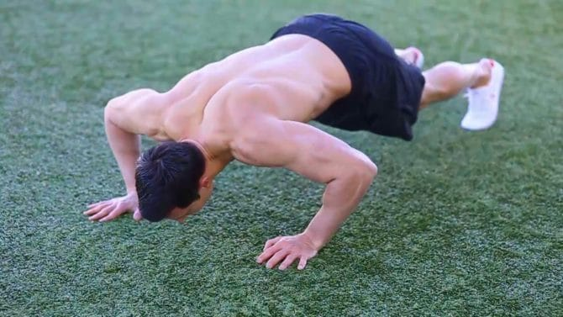
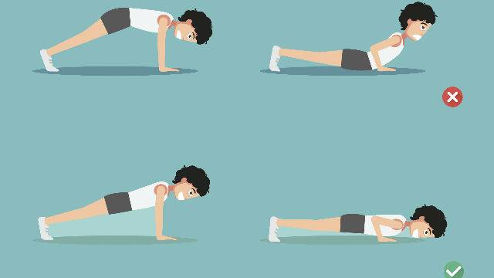
Common Mistakes During Push Ups
Elbows flared too far out
Hips Up
Core unengaged, hips sink
Not going far down enough
Elbows flared out
https://www.builtlean.com/2016/12/15/push-ups-instruction/
Hips up/hips sinking
http://www.ashishhgupta.com/2016/09/19/pump-your-push-ups-fixing-3-common-mistakes/

Slide 10
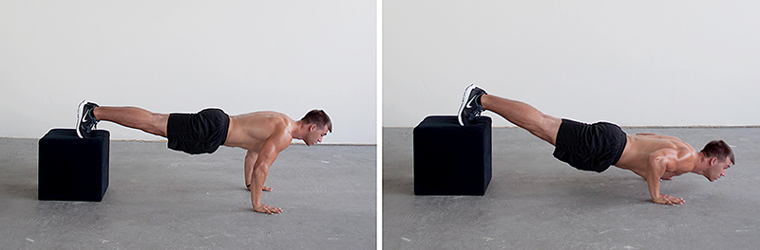
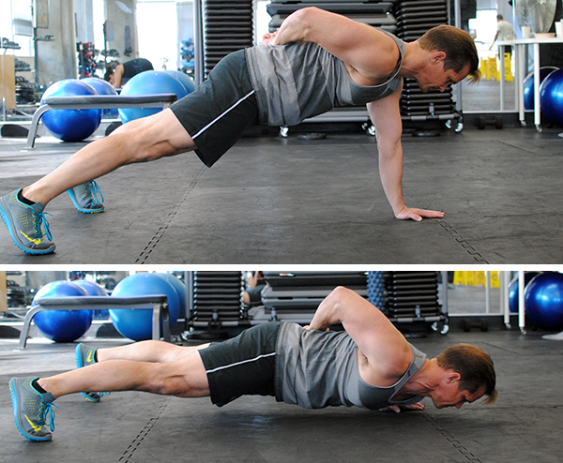
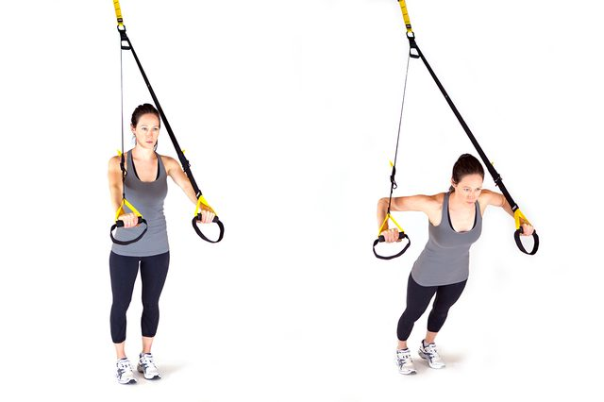
Different Variations
Decline Push Up
  Feet are up on a bench/box
TRX Push Up
  Suspension Push Up
Single Arm Push Up
  Push Up with one arm
https://www.madbarz.com/blog/134-incline-vs-decline-push-ups-whats-the-differe
Decline Push Up
Single Arm Push Up
TRX Push Up
https://www.livestrong.com/slideshow/1011315-8-bodysculpting-trx-exercises-tone-inch/
http://storminintofitness.com/5-genius-push-up-improvements/

